Slide 1
TY MAJOR PROJECT REVIEW

Slide 2

TY Major Project Review
Fire, Flame and Smoke Detection
Guide:
Group Members:
Anushk Nagdekar
Jagruti Waje
Ajeet Verma

Slide 3
INDEX
Introduction
Literature survey
Problem Statement
Software and Hardware requirements
Future Plans
References

Slide 4
INTRODUCTION
Flame, fire, and smoke detection technologies are crucial for early warning systems and fire safety measures in various settings, including homes, businesses, industries, and public spaces.
Fire-related accidents have, on average, killed 35 people every day in the five years between 2016 and 2020, according to a report by Accidental Deaths and Suicides in India (ADSI)
According to another study, about Rs. 1000 crores are lost every year due to fire.
A fire has accounted for 9% of the overall ranking of risks. Fires have been rated as the 5th highest risk in the manufacturing industry.
So, we can see why early fire and flame detection is important.

Slide 5
INTRODUCTION
Here are some common methods and technologies used for detecting flame, fire, and smoke:
Smoke detectors
Ionization Smoke Detectors: These detectors contain a small amount of radioactive material that ionizes the air within the detector's sensing chamber. When smoke enters, it disrupts the ion flow, triggering the alarm.
Heat detectors
Rate-of-Rise Heat Detectors: These sensors trigger an alarm when a rapid increase in temperature occurs within a short period.
Flame detectors
Ultraviolet (UV) Flame Detectors: These detectors use UV sensors to detect the UV radiation emitted by flames. They are effective for detecting fires with high-energy ultraviolet radiation, such as those from hydrocarbon-based fires.
Gas detectors
Carbon Monoxide (CO) Detectors: These detect the presence of carbon monoxide, an odorless and deadly gas produced by incomplete combustion.

Slide 6
INTRODUCTION
Problem with existing technology:
Detection Limitations:
Detection Speed: Some technologies might have limitations in detecting fires in their early stages, especially in large or open spaces, leading to delayed alerts.
Detection of Certain Fire Types: Not all technologies are equally effective in detecting certain types of fires, such as slow smoldering fires versus fast, high-heat fires.
Maintenance and Reliability:
Battery Life and Power Supply: Battery-powered detectors require regular maintenance to ensure proper functioning. Power outages can render some systems ineffective if they lack backup power.
Sensor Degradation: Sensors in detectors may degrade over time, reducing their sensitivity and reliability if not properly maintained or replaced.
Cost and Accessibility:
Affordability: Some advanced fire detection technologies might be cost-prohibitive for smaller businesses or households, limiting their accessibility.

Slide 7
INTRODUCTION
Video analysis for fire, flame, and smoke detection offers a promising approach due to advancements in computer vision, machine learning, and artificial intelligence.
Here's how video analysis can contribute to easier fire, flame, and smoke detection:
Early Detection and Alerting:
Real-time Analysis: Video analysis systems can continuously monitor footage in real-time, enabling early detection and prompt alerts to notify authorities or occupants about potential fire or smoke incidents.
Integration with Alarm Systems: Video analysis can integrate with existing alarm systems, enhancing their capabilities by providing visual confirmation of detected fire or smoke events.
Scalability: Video analysis solutions can be scaled for use in various settings, from small residential spaces to large industrial complexes, making them adaptable to different environments.
Accessibility: Video cameras are readily available in commercial as well as residential setting making this basic safety feature easily available.

Slide 8
2.Literature Review
Let’s start with some papers

Slide 9
TITLE | YEAR | KEYPOINTS | ALGORITHM | PERFORMANCE
Fire-YOLO:A small target object detection method for fire inspection | 2022 | Enhances feature propagation of small targets identification and reduces model parameters. The Fire-YOLO model proposed in this paper is considered from the three dimensions of depth, width, and resolution, and realizes a more balanced network architecture. | Fire YOLO deep learning algorithm | When the input image size is 416 × 416 resolution, the average detection time is 0.04 s per frame, which can provide real-time forest fire detection.The algorithm achieves an mAP of 80.23%

Slide 10
TITLE | YEAR | KEYPOINTS | ALGORITHM | PERFORMANCE
A Small-Target Forest Fire Smoke Detection Model Based on Deformable Transformer for End-to-End Object Detection | 2022 | Multi-scale Context Contrasted Local Feature (MCCL): Integrated to perceive features of small or inconspicuous smoke. Dense Pyramid Pooling Module (DPPM): Added to enhance feature extraction for improved detection. | The proposed model is based on Deformable DETR (DEtection Transfomer with Deformable convolution), which combines the spatial sampling capability of deformable convolution and the relation modeling capability of transformers. | mAP (mean average precision): Improved by 4.2% compared to Deformable DETR.

Slide 11
TITLE | YEAR | KEYPOINTS | ALGORITHM | PERFORMANCE
A Deep Learning Based Object Identification System for Forest Fire Detection | 2021 | The two best-performing models were trained with the dataset labeled with three different smoke classes and with data augmentation. Faster R-CNN was the chosen model architecture, re-trained during the same iterations but following different learning rate schedules. | Utilizes a deep learning-based approach for smoke column classification with object detection. Compares the performance of RetinaNet and Faster R-CNN algorithms. | F1-score: Achieved around 80%.G-mean: Achieved around 80%.Detection Rate: Achieved around 90%.

Slide 12
TITLE | YEAR | KEYPOINTS | ALGORITHM | PERFORMANCE
A Study on a Complex Flame and Smoke Detection Method Using Computer Vision Detection and Convolutional Neural Network | 2022 | This study enhances fire detection by combining color conversion, corner detection, dark channel prior, and optical flow to isolate flame and smoke regions.effectively respond to a fire by detecting all the flame and smoke that may occur in the early stages of the fire.Using deep learning computer-vision based detection using “you only look once”(YOLO) model based on Tensorflow. For this purpose hue,saturation is been used. | Deep learning computer vision-based flame detection studies YOLO model based on tensorflow UAV-Based object detection | 5.5% improvement in flame detection and a 6% enhancement in smoke detection accuracy Other matrix: 92.7 % accuracy in detecting fire using a UAV- based 97.9% F1score by detecting fire using CNN

Slide 13
TITLE | YEAR | KEYPOINTS | ALGORITHM | PERFORMANCE
DeepSmoke: Deep learning model for smoke detection and segmentation in outdoor environments | 2019 | Here present “DeepSmoke” (a deep learning framework for smoke detection and segmentation), by incorporating two essential modules for intelligent disaster management, smoke detection, and segmentation. The key ingredient of framework is its high-level of adaptability to clear and hazy surveillance environments for smoke detection and localization. | (CNN)-based smoke detection and segmentation framework | Improved the False Alarm Rate by reporting a reduction of 1.98%, and by boosting the accuracy to 98.18%. segmentation results reported a significant increase of 2% and 1% in global accuracy.

Slide 14
TITLE | YEAR | KEYPOINTS | ALGORITHM | PERFORMANCE
Flame and Smoke Detection Algorithm Based on ODConvBS-YOLOv5s | 2023 | 1: The ODConvBS module to minimize computational complexity and improve the ability to extract features of the multi-convolutional kernel fusion model. 2: The Gnconv-FPN pyramid structure, which is based on recursive gated convolution, can increase the model’s high-order spatial interaction capabilities, minimize missed detection rates, and improve the detection accuracy of small objects. | ODConvBS in YOLOv5s | Upgraded YOLOv5s model mAP grew by 9.3%. At the same time, the accuracy rate, the recall rate, and the detection speed increased to 83.5%, 83.7%, 33.3FPS respectively.

Slide 15
TITLE | YEAR | KEYPOINTS | ALGORITHM | PERFORMANCE
Early smoke and flame detection based on transformer | 2023 | Multi-dimensional fire features are extracted, and low-dimensional fire semantics are enhanced through the DOT backbone, which consists of DOT blocks and a semantic-augmented attention (SAA)module. The DOT block captures local spatial and global semantic relations at each scale, whereas the SAA exchanges semantic infor- mation between two consecutive feature maps and reinforces their features. | DOT(Detection oriented transformer) SAA(Semantic augmented attention) | Achives an mAP of 87.40% on custom data set and mAP of 81.12% on Kaggle flame smoke dataset

Slide 16
TITLE | YEAR | KEYPOINTS | ALGORITHM | PERFORMANCE
Forest fire and smoke detection using deep learning‑based learning without forgetting | 2023 | (i) Examined various pre-trained CNN models and identified the methods to explore the pre-trained models. (ii) Developed low-cost computation models and analyzed the performance of the variants of CNNs. (iii) Optimized the values for various hyperparameters of CNN models using Bayesian optimization. (iv) Transferred the knowledge learned by the proposed models to a standard, but challenging dataset, BoWFire using LwF. | VGG16, InceptionV3, and Xception | Xception excelled with 98.72% accuracy. We tested the performance of the proposed models with and without LwF. Without LwF, among all the proposed models, Xception gave an accuracy of 79.23% on a new task (BowFire dataset). While using LwF, Xception gave an accuracy of 91.41% for the BowFire dataset and 96.89% for the original dataset. We find that fine-tuning the new task with LwF performed comparatively well on the original dataset.

Slide 17
PROBLEM STATEMENT AND SCOPE
Problem Statement:
Real time Fire, Flame and Smoke detection
Scope:
This system should be compatible with real video footage like cctv.
It must be accurate enough to avoid false alarms.

Slide 18
SOFTWARE REQUIREMENTS
Data Pre-processing:
Data pre-processing involves cleaning, transforming, and organizing raw data into a format suitable for analysis or machine learning. This step includes tasks like data cleaning, normalization, and feature engineering.
Python:
Python is a widely-used high-level programming language known for its readability and versatility. It's popular in data analysis, machine learning, web development, and many other domains.
OpenCV (Open Source Computer Vision Library):
OpenCV is an open-source computer vision library that provides tools and functions for image and video processing, including tasks like image manipulation, object detection, and feature tracking.

Slide 19
HARDWARE REQUIREMENTS
Cloud:
The cloud refers to a network of remote servers hosted on the internet that store, manage, and process data. Cloud computing allows users to access and use computing resources, like storage and processing power, on-demand via the internet.
GPU (Graphics Processing Unit):
A GPU is a specialized electronic circuit designed to accelerate graphics rendering. However, modern GPUs are also used for general-purpose computing tasks, such as machine learning and scientific simulations, due to their parallel processing capabilities.
IoT (Internet of Things):
IoT refers to a network of interconnected physical devices (such as sensors, appliances, and industrial machines) that can collect, transmit, and exchange data with each other and central systems via the internet.

Slide 20
ANALYSIS
What is Accuracy, Precision, Recall and F1 Score?
Accuracy
Accuracy is the most common metric to be used in everyday talk. Accuracy answers the question “Out of all the predictions we made, how many were true?”
Precision
Precision is a metric that gives you the proportion of true positives to the amount of total positives that the model predicts. It answers the question “Out of all the positive predictions we made, how many were true?”
Recall
Recall focuses on how good the model is at finding all the positives. Recall is also called true positive rate and answers the question “Out of all the data points that should be predicted as true, how many did we correctly predict as true?”
F1 Score
F1 Score is a measure that combines recall and precision. As we have seen there is a trade-off between precision and recall, F1 can therefore be used to measure how effectively our models make that trade-off.

Slide 21
ANALYSIS
ALGORITHM | F1 SCORE
VGG16 | 85.06
InceptionV3 | 82.32
Xception | 95.72
ODConvBS in YOLOv5s | 83.59
YOLOV3 | 38.083
Fire YOLO | 40.086
Faster R-CNN | 92.3

Slide 22
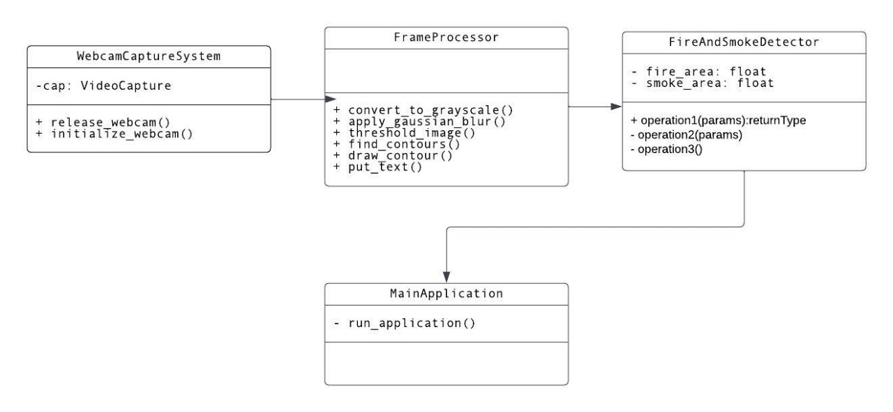
CLASS DIAGRAM

Slide 23
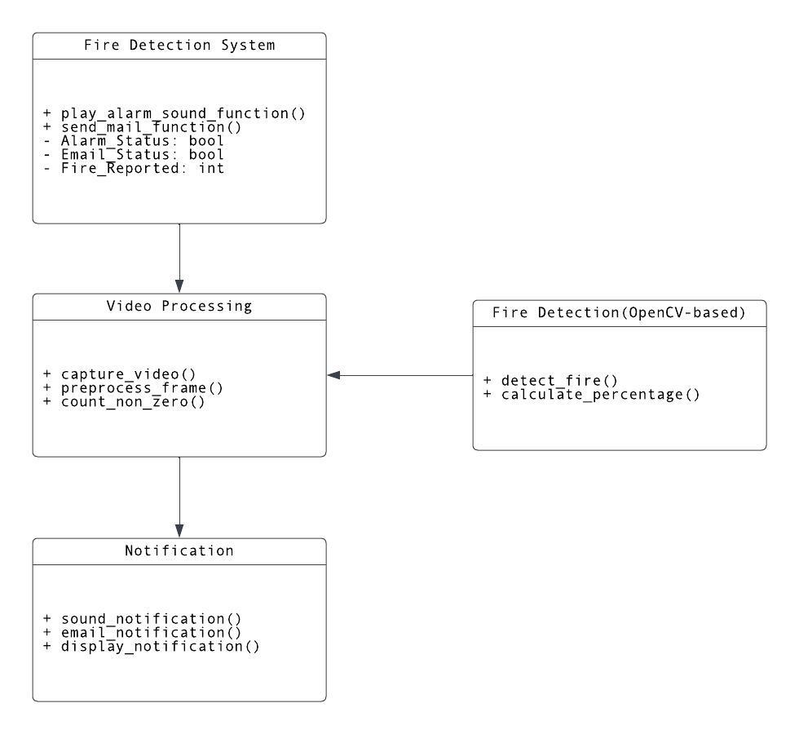
COMPONENT DIAGRAM

Slide 24
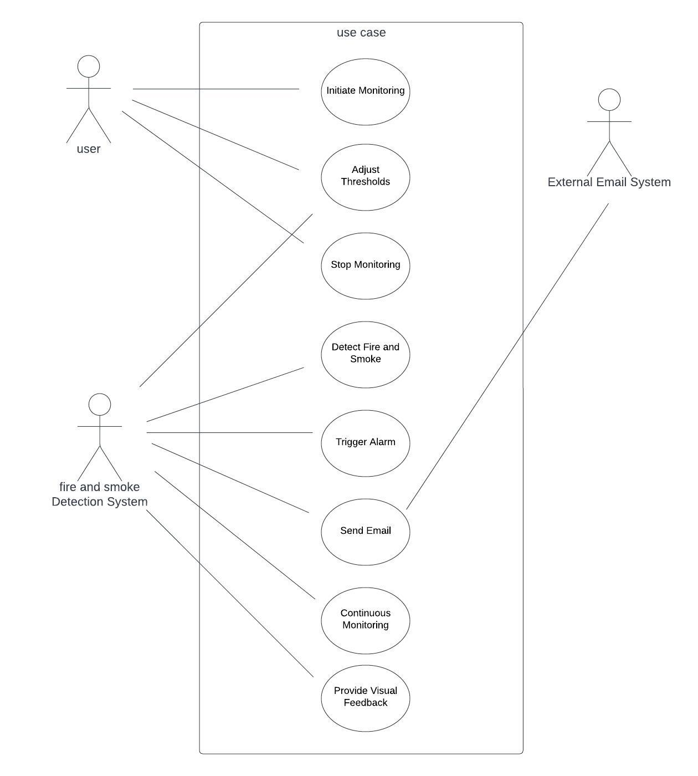
USE-CASE DIAGRAM

Slide 25
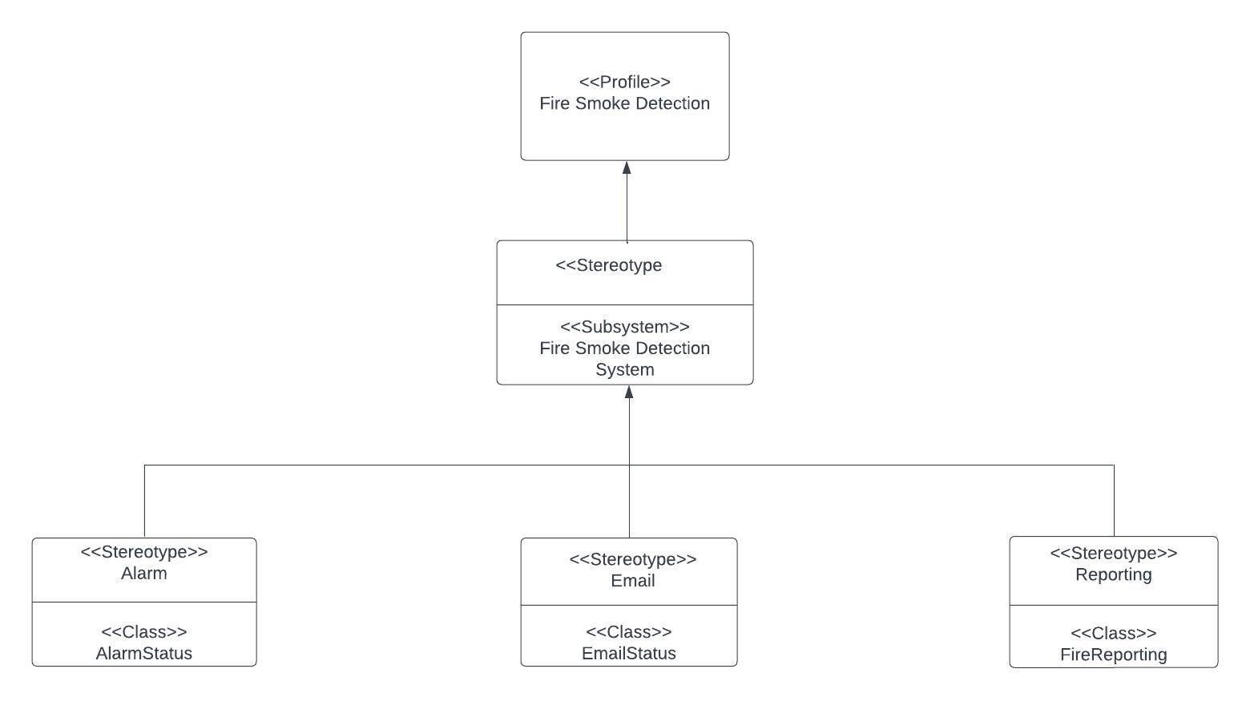
PROFILE DIAGRAM

Slide 26
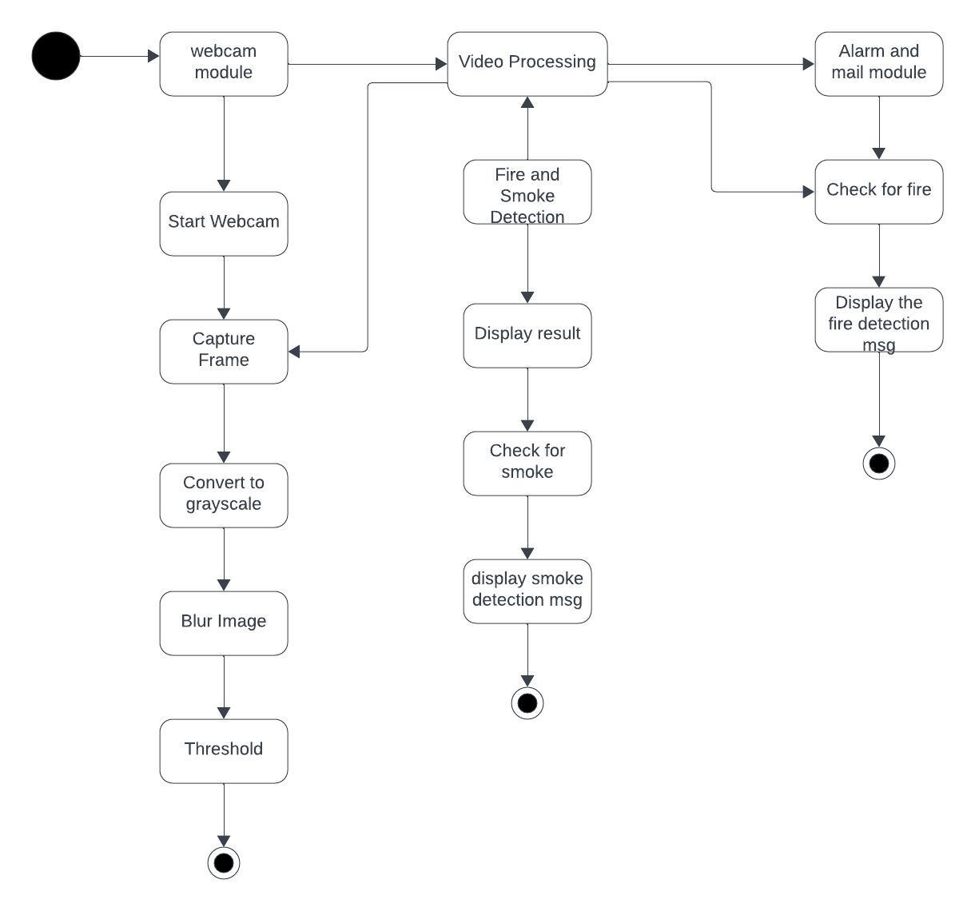
ACTIVITY DIAGRAM

Slide 27
PACKAGE DIAGRAM

Slide 28
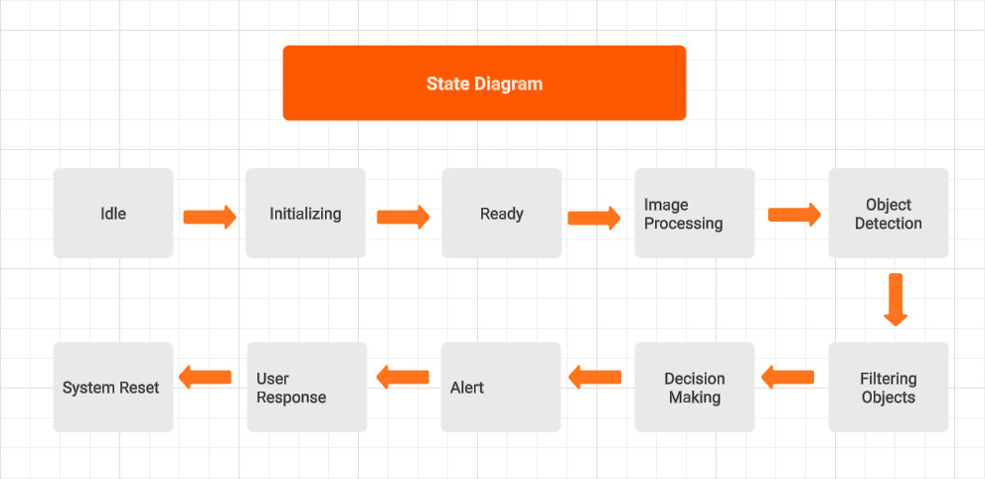
STATE DIAGRAM

Slide 29
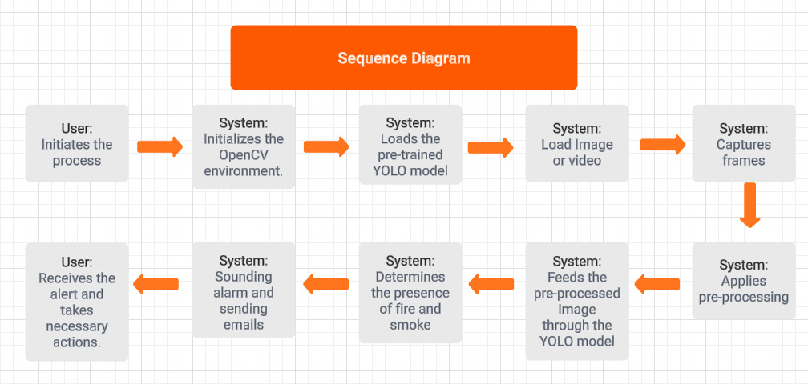
SEQUENCE DIAGRAM

Slide 30
Thank You

